Slide 1
BME 790 Spring 2017 Final Presentation
Author: Daniel A Hagen
Date: 03/27/17

Slide 2


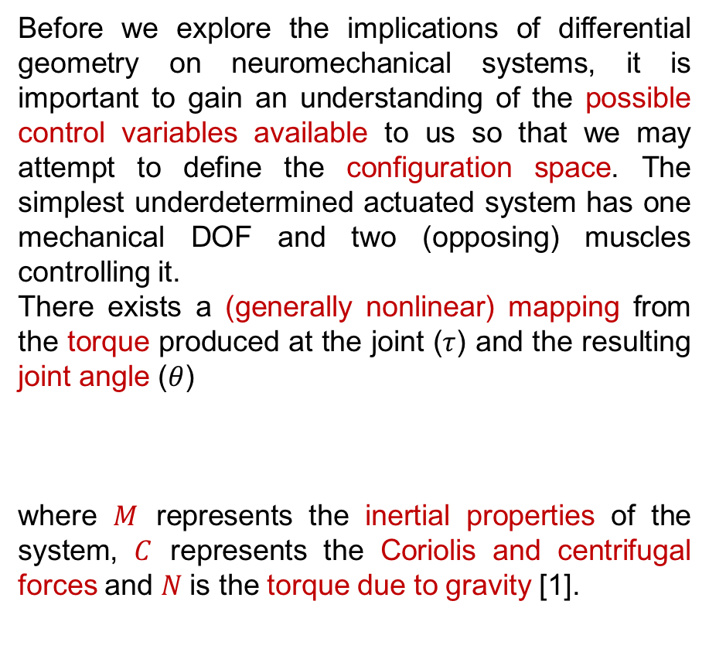
Background
Before we explore the implications of differential geometry on neuromechanical systems, it is important to gain an understanding of the possible control variables available to us so that we may attempt to define the configuration space. The simplest underdetermined actuated system has one mechanical DOF and two (opposing) muscles controlling it.
There exists a (generally nonlinear) mapping from the torque produced at the joint ($τ$) and the resulting joint angle ($θ$)
where $M$ represents the inertial properties of the system, $C$ represents the Coriolis and centrifugal forces and $N$is the torque due to gravity [1].
$$θ$$
$$τ$$

Slide 3
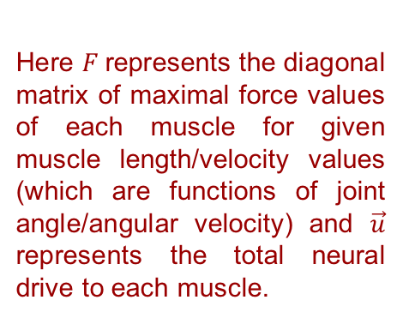
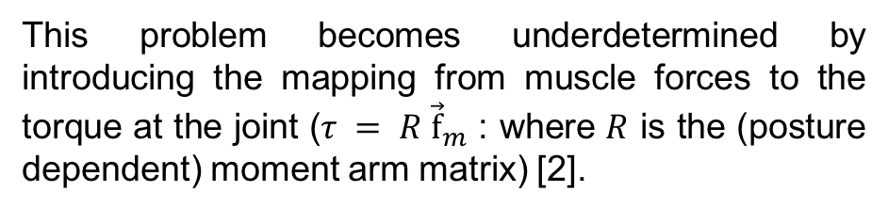




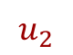
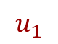
Background
This problem becomes underdetermined by introducing the mapping from muscle forces to the torque at the joint ($τ = R {\vec{f}}_{m}$ : where $R$ is the (posture dependent) moment arm matrix) [2].
Furthermore, a mapping from muscle input to muscle forces can be introduced that retains the same dimensionality, but oversimplifies the control problem.
$$u_{1}$$
Here $F$represents the diagonal matrix of maximal force values of each muscle for given muscle length/velocity values (which are functions of joint angle/angular velocity) and $\vec{u}$ represents the total neural drive to each muscle.
$$f_{1}$$
$$θ$$
$$u_{2}$$
$$θ$$
$$f_{2}$$

Slide 4
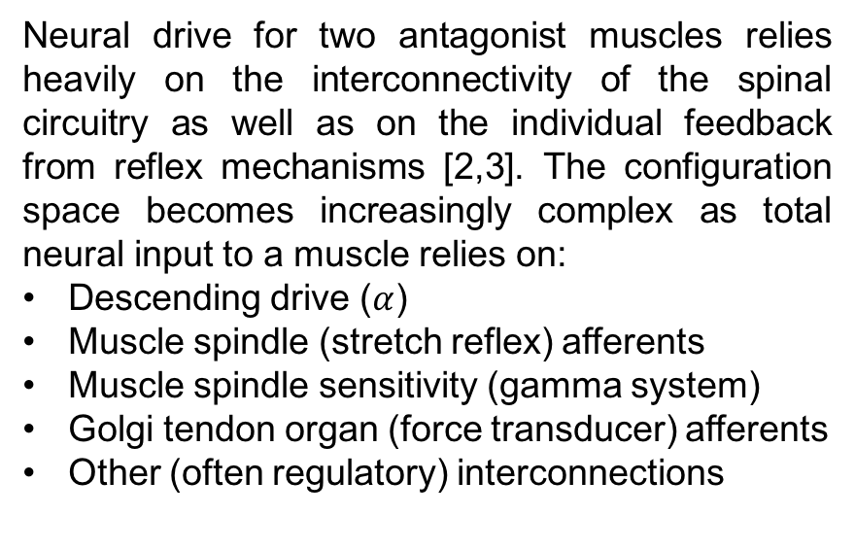
Background
Neural drive for two antagonist muscles relies heavily on the interconnectivity of the spinal circuitry as well as on the individual feedback from reflex mechanisms [2,3]. The configuration space becomes increasingly complex as total neural input to a muscle relies on:
Descending drive ($α$)
Muscle spindle (stretch reflex) afferents
Muscle spindle sensitivity (gamma system)
Golgi tendon organ (force transducer) afferents
Other (often regulatory) interconnections

Slide 5
So what is the Configuration Space?

Slide 6
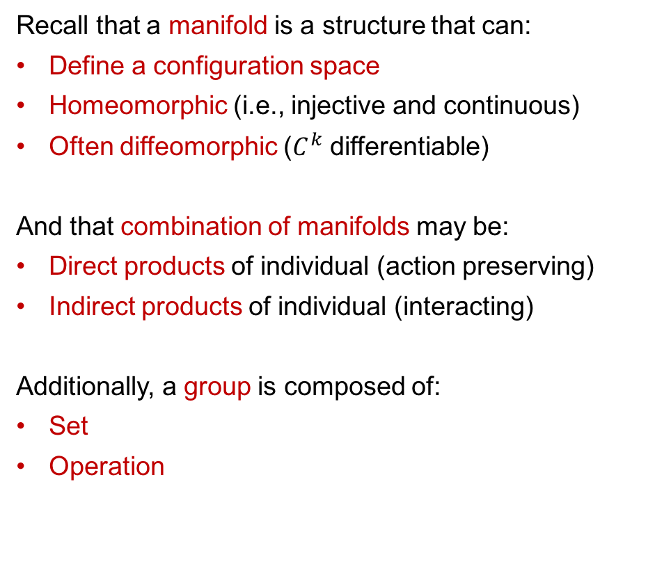
Manifolds and (Lie) Groups
Recall that a manifold is a structure that can:
Define a configuration space
Homeomorphic (i.e., injective and continuous)
Often diffeomorphic ($C^{k}$ differentiable)
And that combination of manifolds may be:
Direct products of individual (action preserving)
Indirect products of individual (interacting)
Additionally, a group is composed of:
Set
Operation
Not only must we define the configuration space for the control problem, but we must define the operation that each individual set possesses. (What is the action of one activation strategy on another?)
Once this is established, the group is a Lie group if it has:
Closure
Associativity
Identity element
Inverse operation
Without this definition on the chosen manifold then the techniques discussed throughout this semester will not be applicable.

Slide 7
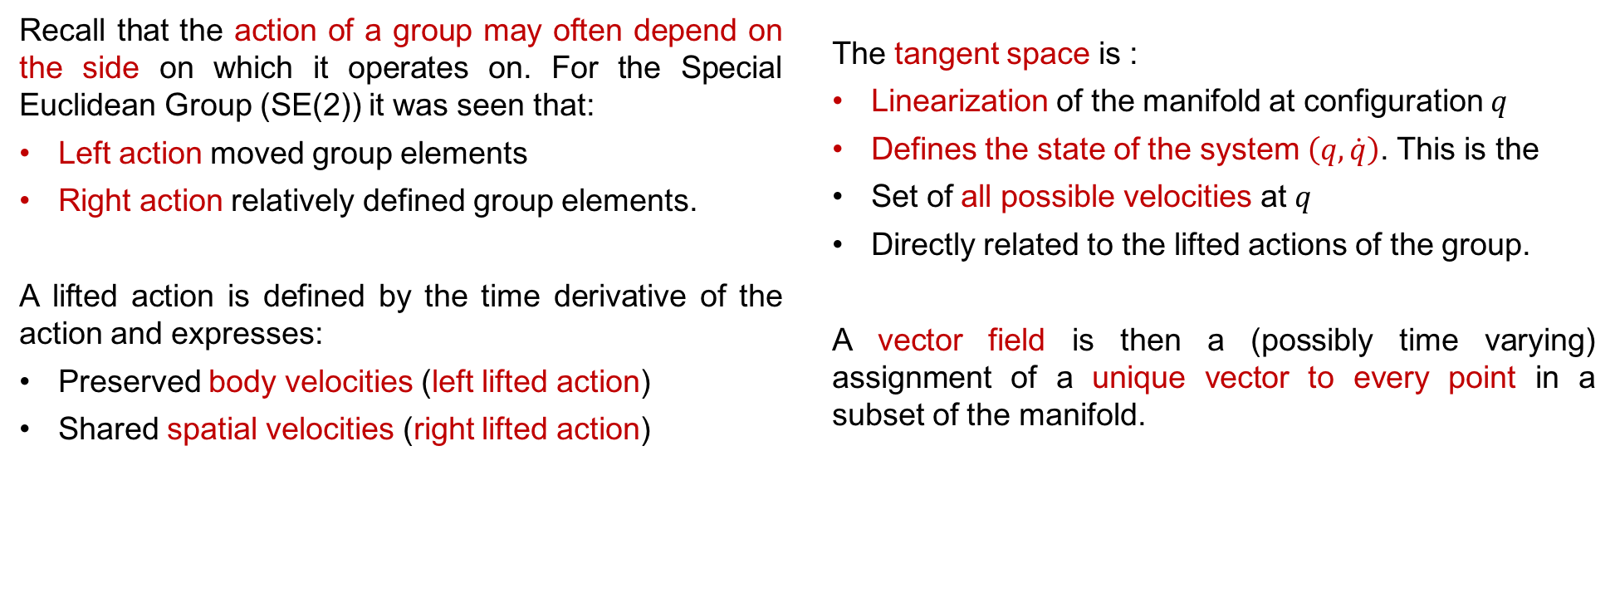
Actions, Lifted Actions, and Tangent Spaces
Recall that the action of a group may often depend on the side on which it operates on. For the Special Euclidean Group (SE(2)) it was seen that:
Left action moved group elements
Right action relatively defined group elements.
A lifted action is defined by the time derivative of the action and expresses:
Preserved body velocities (left lifted action)
Shared spatial velocities (right lifted action)
The tangent space is :
Linearization of the manifold at configuration $q$
Defines the state of the system $\left(q,\dot{q}\right)$. This is the
Set of all possible velocities at $q$
Directly related to the lifted actions of the group.
A vector field is then a (possibly time varying) assignment of a unique vector to every point in a subset of the manifold.
For the neuromechanical system, the time derivatives of many of these variables – defined by the current state of the system (and the current vector field of the local manifold) – define the (local) interactions of variables.
Notes:
If the manifold is simply defined by the direct product of lines (as may be the case for activation space) then the order of the action is irrelevant and the resulting lifted
actions become trivially identity (addition by some value to one activation does not change its relative velocity to itself (or others)).

Slide 8
Goals
Apply constraints on the input parameter manifold (holonomic or nonholonomic)
Find input parameters vs. output relationship (ideally shape vs. position!)
Create connection vector fields to better understand “similar gait cycles”
Use constraint curvature to understand resulting “movement” through the chosen configuration space.

Slide 9
Constrained Articulated Systems
For an articulated system, tools such as holonomic constraints, nonholonomic constraints, and Jacobian operators allow for an understanding of the relationship between shape and position variables.
Mainly, these tools allow a constrained system to “move” while maintaining the local mapping of parameter values.
Recall that position defines the location and orientation of the body frame, while the shape defines the relative “placement” of the system to the body frame.
A sufficient choice of body frame requires that all other frames of the system be recoverable through a function of shape parameters. What would be the position/shape variables of the neuromechanical system?
Locomotion is defined informally as the process of using reaction forces to turn internal shape changes into external position changes while subject to restrictions like velocity constraints, momentum, etc. This does however require that locally every position velocity be a linear function of shape velocity.
It is also imperative that the system be symmetrical – i.e., it must allow for actions that, once performed, leave the system indistinguishable from the starting position/orientation.
In a uniform environment, the dynamics of locomotor systems are symmetric, but would the use of muscle activations or lengths be symmetric as well?

Slide 10
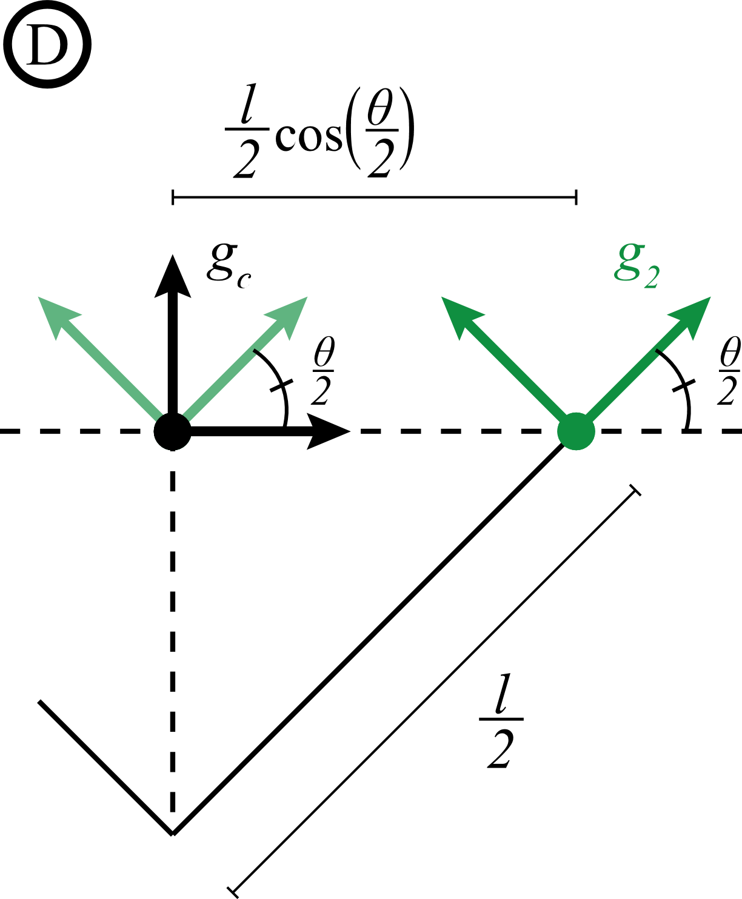
Constrained Articulated Systems
Closure: any two symmetry-preserving actions can be combined to make a third.
Associativity: the order in which consecutive symmetry-preserving actions are performed does not matter.
Identity: objects are trivially symmetric when no action is performed (null action).
Inverse: any symmetry-preserving action may be undone.

Slide 11
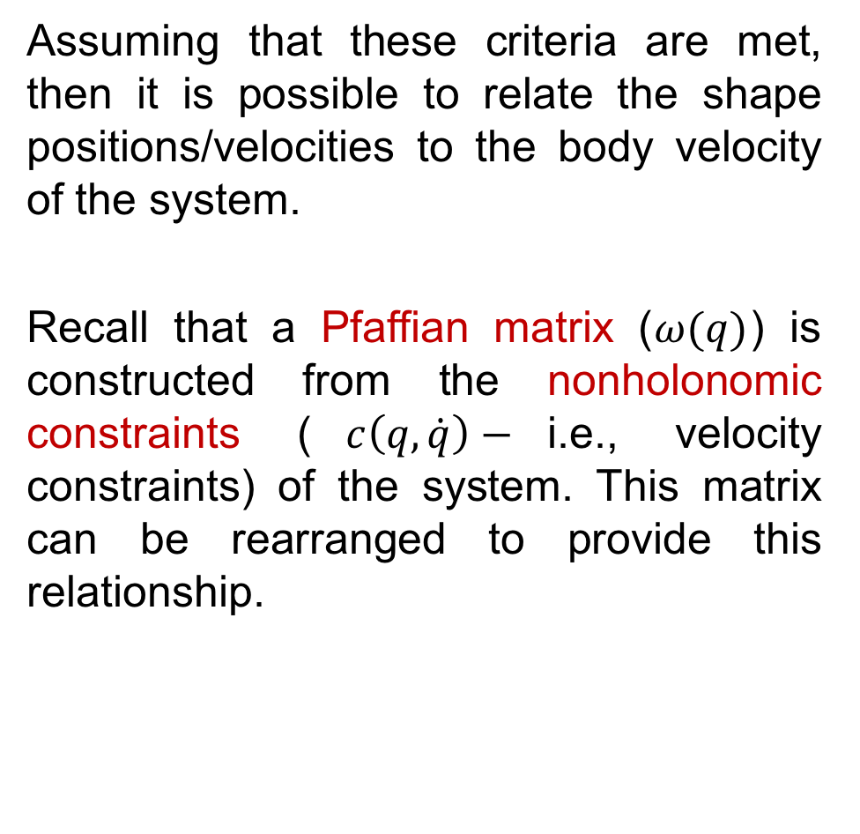
Pfaffian Matrices and Connection Vector Fields
Assuming that these criteria are met, then it is possible to relate the shape positions/velocities to the body velocity of the system.
Recall that a Pfaffian matrix ($ω(q)$) is constructed from the nonholonomic constraints ($c\left(q,\dot{q}\right)−$i.e., velocity constraints) of the system. This matrix can be rearranged to provide this relationship.

Slide 12
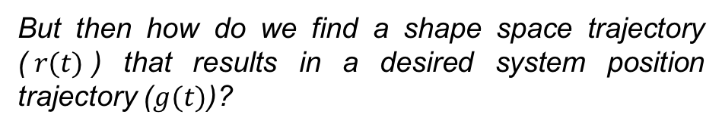
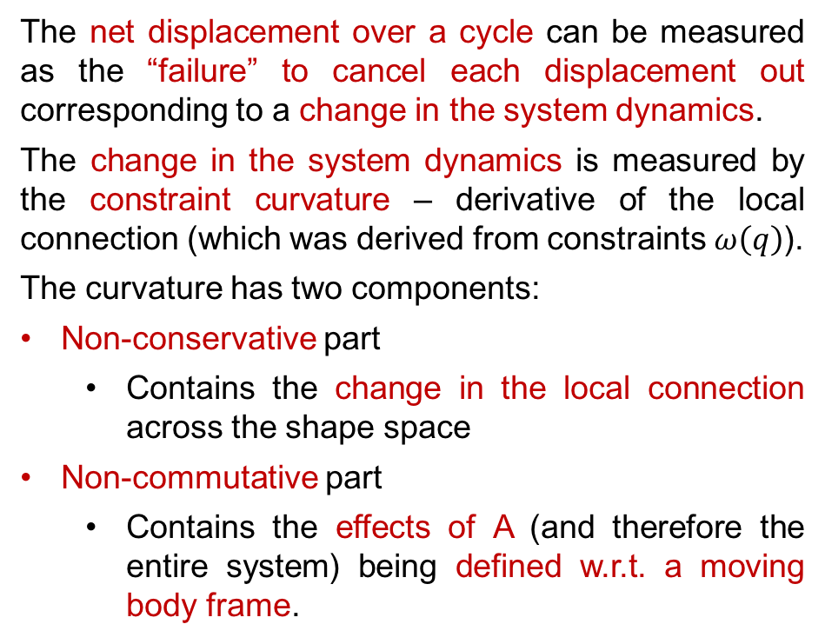
Gaits
If such a relationship exists we can find the movement of the body frame w.r.t. a given shape trajectory by:
The net displacement over a cycle can be measured as the “failure” to cancel each displacement out corresponding to a change in the system dynamics.
The change in the system dynamics is measured by the constraint curvature – derivative of the local connection (which was derived from constraints $ω\left(q\right)$).
The curvature has two components:
Non-conservative part
Contains the change in the local connection across the shape space
Non-commutative part
Contains the effects of A (and therefore the entire system) being defined w.r.t. a moving body frame.
But then how do we find a shape space trajectory ($r(t)$) that results in a desired system position trajectory ($g(t)$)?

Slide 13
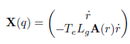
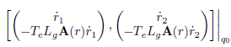
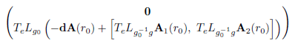
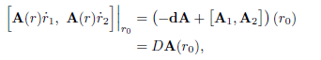
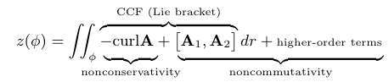
Gaits
The approximation of the net displacement then takes into account both the displacement caused by the change in connection vector fields (using Stokes thm to calculate the line integral as the area of the region encircled in the vector (height) function) and the movement caused by the choice of (moving) body frame.
*Equations above taken from Choset’s .ppt presentations on the subject, available through https://sites.google.com/site/16742geometryoflocomotion/course-notes [3,4]

Slide 14
Conclusions/Impressions
We must take great care to identify the proper groups we will be considering for our configuration space manifold – but more specifically, we need to define the action of the group to allow for any further analysis.
In addition, great care must be taken to ensure that the system is classified as a symmetric linear-kinematic locomotor otherwise the (local) relationship between shape and position will not hold.

Slide 15



Acknowledgements
Special thanks to Dr. Paul Newton and Dr. Francisco Valero-Cuevas for their guidance throughout this research and thanks to Dr. Howie Choset for sharing his research on Differential Geometry as well as an advanced version of his book.
Funding provided by:
R01AR052345 & R01AR050520
References
[1] Venkadesan, M. and Valero-Cuevas, F.J.. "Neural control of motion-to-force transitions with the fingertip." Journal of Neuroscience 28.6 (2008): 1366-1373.
[2] Valero-Cuevas, F.J., 2015. Fundamentals of neuromechanics (Vol. 8). Springer.
[3] Kandel, E.R., Schwartz, J.H. and Jessell, T.M. eds., 2000. Principles of neural science (Vol. 4, pp. 1227-1246). New York: McGraw-hill.
[4] Choset, H. and Hatton, RL, 2015. An Introduction to Geometric Mechanics and Differential Geometry
[5] Online Materials available at: https://sites.google.com/site/16742geometryoflocomotion/home

